Slide 1
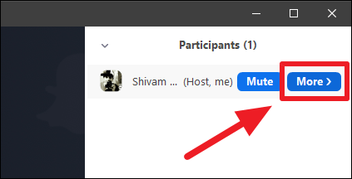
Welcome EFAP Contractors!
Rename yourself – [Name, Organization, pronouns]
Use the chat panel to introduce yourself
Name, organization, location, etc.
Make sure your messages are sent to “All Attendees”
Automated captioning is enabled. Click “Live Transcript” to hide and unhide.
Tech Problems? Close everything and sign back in (maybe use a different browser) – this usually resolves any issues.
Listen in by phone by calling (253) 215-8782; Meeting ID 833 5235 1419. Press *6 to mute and unmute.
Need to leave early? Recording and slides will be sent with follow up materials

Slide 2
AGENDA
Setting Up Zoom – What to turn on?
Assigning Roles - notetaker, facilitator, producer
What to expect from attendees (will they join by phone? Video?)
Accessibility
Meeting Preparation – What to tell attendees?
Invitation and pre-meeting materials
Agenda – Introduction, Votes, Q&A
Expectations – video, audio, online voting, “change type of contracts?”
Logistics – link, best practices
The “Security” Button – What to allow attendees to do?
Unmuting, renaming, screensharing, annotating
The Tools – How to take attendance and vote?
Google Docs, Zoom annotation and/or Breakout Rooms
Saving chat
Open discussion and Q&A

Slide 3
SETTINGS

Slide 4
PRE-MEETING EMAIL
HOW TO JOIN THE MEETING
Click the link below 5-10 minutes before the meeting begins (if you do not have the Zoom app installed on your computer, you will be prompted to download it)
Type in your name and organization and wait for a moderator to let you into the room
If you would like to connect using a telephone, dial (253) 215-8782 and enter the Meeting ID ### #### ####. Press *6 to mute and unmute.
Webinar Link: **Automated captioning will be enabled for this webinar. Please contact us if you have any questions or concerns.

Slide 5
PRE-MEETING EMAIL
BEST PRACTICES WHEN CONNECTING
Make sure your webcam and microphone work. If you are using a laptop, these are probably built-in)
Use a hardwired, ethernet connection if you can. WiFi is too spotty for consistent, high-quality webinar interaction
Use a headset if you have one. At the very least, earbuds or headphones will improve how you sound to others
Find a quiet room that has good lighting, but do not sit with your back to the light source. Think of how you would take a good photo - you don't want to be a silhouette
Check out this Zoom Participant Guide for help on getting started with Zoom and this overview on using Zoom breakout rooms.

Slide 6
ATTENDEE PERMISSIONS

Slide 7
TAKING VOTES

Slide 8
BREAKOUT ROOMS

