Slide 1

EFAP Spring Meeting Training
March 15, 2021
3/15/21
March 2021 WFC
Notes:
Welcome & thanks for being here today. Does everyone know where their reactions button is?
How many of you on the call today are contractors?
Subcontractors?
Interested in learning more about EFAP?
Thanks to Mallorie and Kyle for their assistance and for being here today. Food System Support at Solid Ground - stealing their PowerPoint.

Slide 2
What we will cover today:
Overview of EFAP & your EFAP Spring Meeting
Why are you required to hold these Spring meetings?
Getting ready for your meeting.
What information will be provided to you as a Contractor:
    EFAP Policies and Procedures
    EFAP Application Handbook
    Spring Meeting Handout
    Contracts
    Where to find this information –
    https://agr.wa.gov/services/food-access/hunger-relief-agency-hub/fa-forms-and-pubs
Understanding Terminology
Role of Contractor/Subcontractor
How does the State allocate funds to contractors?
Examples of how Contractors divide their funds to their Subcontractors
Virtual meetings – what does that look like?
    Training on Friday, March 19th 2 to 4 p.m.
Anything to add?
Notes:
This training is being held to assist contractors, old and new, with their EFAP Spring meetings. As we just learned not everyone on this call today is an EFAP Contractor/subcontractor but hear to learn more about EFAP funding and the process.
I’m really going to try to focus on EFAP Spring meeting – so will concentrate on answering those questions and leave others to the end. So, if you have a question, please raise your hand or write your question in the Chat box. We will stop briefly after each slide to check in. Mallorie has kindly offered to check the chat box.
I also hope that throughout this presentation you will share your best practices and ideas on how you have handled some of the decisions.

Slide 3
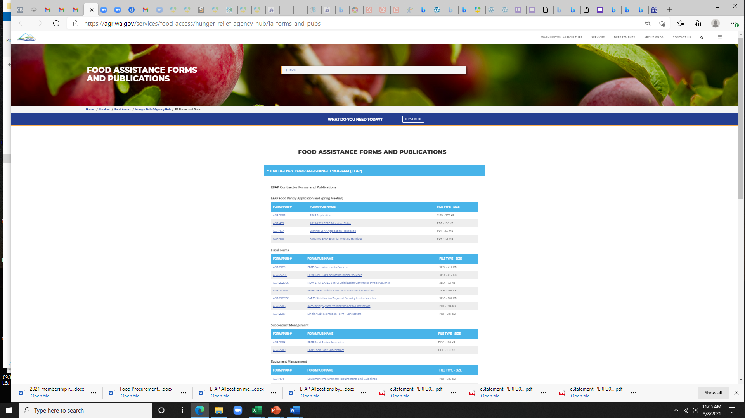
Where to find this info -
EFAP Policies and Procedures
EFAP Application Handbook
Contracts
Spring Meeting Handout
These documents are currently being updated and WSDA will notify you when they are finalized for this Biennium.
Where to find this info – WSDA website
https://agr.wa.gov/services/food-access/hunger-relief-agency-hub/fa-forms-and-pubs
Notes:
You will be receiving a lot of information from WSDA. Review and understand these polices and procedures. Kyle is going to briefly talk about these documents. If you have questions, contact your EFAP rep.
Mallorie is going to add the EFAP application, Handbook, Policies and Procedures and the eligibility of Subcontractors into the chat box.

Slide 4
Overview of EFAP -
Emergency Food Assistance Program (EFAP):
    State general funds granted by WSDA (WA State Department of Agriculture)
    Distributed since 1985
    Allocated every two years to food pantries/banks only at the beginning of the state's fiscal biennium. (July 1, 2021 – June 30, 2022)
    EFAP funds are awarded to a locally selected "Contractor" in every county. (three in King County)
    The funding is flexible and may be used for the purchase of food, operational costs, nutrition education and equipment or repairs. How do you & your subcontractors use your EFAP funds?
    Currently, EFAP provides funding to about 330 food pantries and food bank distribution centers.
    The decisions you’ll make in your meeting will affect the next biennium of EFAP funding, July 2021 – June 2023
Notes:
Start with an overview of EFAP – for some of you this is old info but a quick review never hurts. New contractors – for everyone’s information what EFAP is all about.
How do you use your funds? Unmute and share.

Slide 5
Why a Spring Meeting?
.
This is how WSDA Food Assistance directs us to make decisions.
As required by the legislature, EFAP funds are awarded to a locally selected Contractor in every county, and they are responsible for convening every other food pantry and food bank in their community to democratically determine how funds will be spent toward the local hunger relief organizations for the following 2-year contract period.
Eligible organizations apply through the lead contractor in each county to participate as a food pantry or food bank distribution center. The exception is tribes participating in the EFAP - Tribal program.
Locally elected Contractors must submit an EFAP application in May of odd years.
Notes:
Required by the Legislature- these funds are awarded to a locally selected contractor in every county. That contractor is responsible for convening the pantries and others, to determine how these funds will be allocated for the following 2-year period.
Contractor pulls together the application for those eligible organizations. Application due in May.

Slide 6

Be Prepared!
Meeting prep! Read through and be familiar with the EFAP Policies and Procedures and the Spring Meeting Handout.
Look at last biennium’s meeting minutes & funding allocations.
If a Lead Contractor serves more than one county, then they must get a vote from Subcontractors in each county to determine if they would like to have separate Spring Meetings or combine their Spring Meeting with the other county(ies) served by the Lead Contractor.
Mandatory Attendance -Find a date that works for your subcontractors, notify the State. (Give WSDA two weeks’ minimum notification.) Absentee ballots are required of those not present, if no proxy appointed. Create a ballot, remind folks about having a proxy if they cannot make the meeting.
Determine process for running meeting, taking votes. (ex. Robert’s Rules of Order) Training on Friday to cover voting.
To approve a motion, you must have approval from at least 2/3 of all EFAP subcontractors. Not just those that are present.
Please know if you get stuck during the meeting and can't make a decision; you can schedule another meeting.
Provide written minutes from the meeting, not a recording.
Contractor EFAP Biennial Application is due by May 15th, with minutes.
Notes:
The most important part of your Spring Meeting is being prepared! If new, look at last biennium’s meeting notes and funding formulas. Were there stinking points, concerns, discussion? File on each subcontractor – issues, problems.
In Seattle, they create an EFAP advisory committee which helps to plan and run the meeting and offers funding allocation options. Spread the joy!
How do you prepare?
Will cover the role of the contractor and their responsibilities in upcoming slides.

Slide 7
Before the Meeting
You must put in a good faith effort to notify all food pantries in your county of the Biennial Meeting. This means outreach to known interested parties and food pantries, and publicly having the information available for potentially unknown interested parties.
For example, have the notification posted on your website.
  There is an example of a Biennial Meeting Notification Template in the EFAP Application Handbook for reference.
If a new food pantry in your county or multi-county region is interested in participating, then the prospective agency must notify the Contractor of their intent to participate, and Contractor must verify they are eligible before the meeting.
  See the “Eligibility of Subcontractors” slide for more info on this.
Notes:
Notify all food pantries in your county – tall order. What other ways could you publicize the meeting? Website, talk up at meetings, share with other social service agencies, social media.
We'll cover it later but who can tell me what it means for a subcontractor to be eligible?

Slide 8
How funds are allocated to counties:
Each county shall receive a base amount of $10,000 each fiscal year.
The remaining funds shall be distributed by each county's percentage of the state’s population with incomes at or below 100 percent of federal poverty guidelines based on the current 5-year average Census Bureau’s American Community Survey data.
Notes:
I was asked how funds are allocated to counties – quick slide to explain that. Any questions?

Slide 9
Definition of Terms:
Food Bank – Distribution center that provides food to food pantries.
Food Pantry – Provided direct service to clients.
Subcontractor – Any association, tribe or organization that, by subcontract with contractor, is performing all or part of the services under their contract with the WSDA.
Contractor - association, organization, tribe or individual that entered into a contract with WSDA to provide emergency food assistance within a county, multi-county region or tribal area.
* The State has different terminology for food banks/food distributors. For the purpose of this meeting, we will identify subcontractors as food pantries.
Notes:
SO this gets a little confusing – terminology can get tricky. In the case of these meeting – Subcontractors=food pantries.

Slide 10
Contractor is responsible for:
Entering into subcontracts with each food pantry participating in EFAP
Monitoring subcontractor’s performance for compliance with all policies and procedures including client tracking, food safety, timeliness and accuracy of reports, practicing nondiscrimination, and fiscal soundness.
Providing technical assistance to help subcontractors carry out EFAP responsibilities
Acting as a conduit for information.
Meeting regularly with subcontractors to share resources and information, as necessary.
Managing subcontracts including collecting reports, tracking data, monitoring spending, reimbursing programs or vendors, and conducting site visits.
Contractor Roles:
The Contractor may be allocated up to 10% of the county allocation.
Notes:
Most of you are Contractors - Who can tell me what are you responsible for?

Slide 11
Votes & Decisions to be made at your spring meeting:
Key votes made at Biennial Spring EFAP meeting:
Before the meeting: If a Lead Contractor serves more than one county, then they must get a vote from Subcontractors in each county to determine if they would like to have a separate Spring Meeting or combine their Spring Meeting with the other county(ies) served by the Lead Contractor.
Vote to accept new Food Pantries – new subcontractors are denied only if there is a 2/3 vote of duplication of services.
Vote on who the Contractor will be.
Vote on who the Food Bank Distribution Center will be, if applicable.
Vote on funding allocated for:
  Contractor
  Food Bank Distributor Center (Can be allocated up to %)
  Other Agencies – WFC, others (Up to 1%)
  Equipment Purchases
  Food Pantries allocation
  Approve a process for determining the use of future funding increases mid-biennium.
    At a minimum, the Contractor must agree to inform all Subcontractors of funding increases and planned spending of those dollars in the county.
    At a maximum, the Subcontractors may require a vote on allocation of all increased funds, giving them decision-making authority on the use of those funds.
  Other decisions –
    Bulk Purchasing -What types of food to prioritize?
    Confirm how funds will be reallocated if a food bank closes.
    Confirm how to vote mid-biennium, if needed
      #1 E-mail vote
      #2 Conference call vote
      #3 In-person voting meeting
Vote to allocate a percentage of the whole, or specific dollar amounts. Dollar amounts will be determined once the WA state budget is final.
Notes:
Fit a lot onto this slide – very important.
There is always the possibility that another organization can express interest in being the contractor – protocol to follow – invited to meeting and given time to present their case at meeting.
Order of Votes is up to group:
The order of allocating funds is up to the Meeting participants, not determined by WSDA
Vote on funding allocated for: can be time consuming and take several votes.
Contractor
Food Bank Distributor Center
Other Agencies – WFC, others
Equipment Purchases
Food Pantries allocation

Slide 12
Definitions
Indirect costs are costs used by multiple activities, and which cannot be assigned to specific cost objects. They can be administrative or operational.
Administration costs are limited to 10% of the contract award. If preforming 2 functions (Contractor and distribution center) costs are limited to 15% of the contract award for administrative expenses. An additional 1% is allowable for membership dues such as Washington Food Coalition.
Food Pantry Operations are expenses that can be direct charged to the operations of a food pantry. Examples are space, salaries, distribution, insurance, utilities, food, etc.
Food Bank Operations are expense that can be direct charged to the operations of a food bank (distribution center). Examples are space, salaries, distribution, insurance, utilities, food, etc.
Equipment costs are any tangible nonexpendable personal property with a useful life of more than one year. Examples are a refrigerator, forklift, truck, lift gate, etc.
SDN (Special Dietary Needs) Food SDN - Special needs populations may include infants, children with disabilities, pregnant and lactating women, people with chronic diseases, people with acquired immune deficiency syndrome, people with lactose intolerance, people with chewing difficulties, alcoholics, intravenous drug users, and people with cultural food preferences
Notes:
When the contractor and subcontractor =Application Here are some of the terms you will see. Not too many food pantries take Indirect or admin costs, but it is a possibility. These are more likely used by a contractor.

Slide 13

Who gets a Vote?
Votes may be permitted as follows:
Each separate organization gets a vote (an organization might have more than one site)
Each food pantry site gets a vote
Food Bank Distribution Centers are not allowed a vote.
The Lead Contractor (which might also serve as a Food Bank Distribution Center) may vote on everything other than who should be the Lead Contractor.
  If the Lead Contractor is also a food pantry, then they may only get one vote.
  WSDA will cast a deciding vote if there are not enough eligible votes for determining a 2/3 majority (i.e., there are less than 3 votes in the County)
Notes:
In online platforms like ZOOM, voting can be done through Polls or reactions or annotates. That will be covered in Friday’s training.

Slide 14
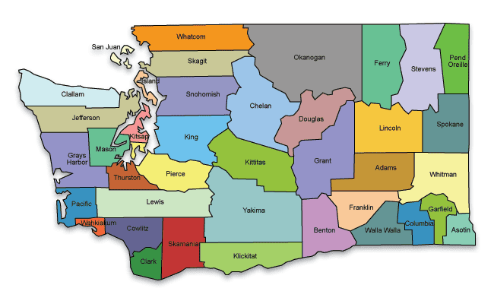
How Counties Divide their Funds: -
Example #1
Contractor admin 10%
WFC 1%
Food Pantries 54%
Food Bank Operations 35%
Example #2
Contractor admin 10%
Food Pantries 69%
Equipment 20%
WFC dues 1%
Example #4
Contractor Admin 10%
Food Bank Operations #1 75%
Food Bank Operations #2 10%
SDN 5%
Example #3
Contractor Admin 10%
Food Pantries 46.4%
Food Bank Operations 49.9%
WFC .7%
Notes:
There are a variety of models on how EFAP can be allocated, they vary across the State. Are you interested on looking at another way of distributing funds? Plan and propose. Options to present to the subcontractors – place to start.
In these examples, shows a variety of ways to distribute funds. Funds could be split between contractor and food pantry subcontractors; in some instances, all funds go to the contractor. Or contractor, Food Bank Distributor & food pantries. Admin rates vary and can or can not be taken.
How are funds divided in your region? Are there unique circumstances in your area that need to be considered?

Slide 15
Eligibility of Subcontractors:
Subcontractors are not duplicating services?
  The only way to prevent an otherwise eligible organization from participating in EFAP is if they are duplicating services already provided by other EFAP organizations. In this case, an organization is voted by 2/3 of eligible voters to be duplicating service and can not participate.
    Duplicating services could mean, serving the same population, serving on the same days, or providing services already available through existing EFAP food pantries.
Look at subcontractor’s contracts and required materials for more detail.
    The food pantry has been active for at least one year prior to the start of the contract
    The Food Pantry has to have been distributing food, and engaging in client data collection practices, and has had set hours of operation for the duration of the year.
    The food pantry must have adequate facilities and is subject to a site visit in advance.
    A 501 c 3 organization as determined by the IRS, is a public agency, or a recognized tribe with active status for at least one year.
    Registered with WA Secretary of State
Notes:
For some of you in a large metropolitan area there are many programs – if a new program wants to be added to EFAP they have to be voted on and should not be duplicating services
Letters of determination from IRS on file
Check that they are registered and maintain their status with State
Food Procurement Policy, Liability Insurance, Register with 211, Have client eligibility and client privacy policies in place.

Slide 16
Contract Types with Subcontractors
1. Reimbursement Contract
  Food Pantry is reimbursed directly for allowable expenditures.
  Must have adequate accounting procedures and internal control measures
  Fidelity/employee dishonesty insurance
  Submit an Audit or Accounting System Verification Form
2. Food/Supplies Contract Only
Contractor pays vendors directly on program’s behalf.
Notes:
See notes #2

Slide 17
Examples of Funding Options for Food Pantries
Determine funding formula for individual food pantry allocations. These have been voted upon.
Seattle: Using a $1,500 base plus a proportional allocation based on service statistics (no indication of new, returning or combination).
Thurston: Subcontractors are allocated funds based on their percentage duplicated client numbers. If a subcontractor receives less than $2000 based on client data, they will receive a flat amount of $2000.
Whatcom: Subcontractors are allocated funds proportionally based on total client visits during a 12-month period.
Kitsap: Equal division of funds among food pantry subcontractors.
Skagit: Food Pantry allocation determined using percentages of EFAP duplicate client visits.
Franklin: $4,500 base plus percentage of new (unduplicated) clients per subcontractor.
NE King County: 50% census (185% of federal poverty level), 50% unduplicated individuals served are the two factors that are used in determining the percentages going to each subcontractor.
Notes:
Several of you asked us to share what other counties are doing to allocate funds to their subcontractors. As you can see everyone does this differently. How do you divide your funds to subcontractors?

Slide 18
Questions?
Notes:
Time available

Slide 19

Transitioning to a Virtual Subcontractor Meeting
Friday, March 19th
2pm-4pm
How will you hold the votes? Are you ready to be a Zoom Meeting Host?
Topics covered:
Virtual Meeting Preparation – Security and Accessibility
Pre-Meeting Communication – Setting Expectations
Taking Attendance and Taking Votes - Using Google Docs, Zoom Polling, and more

Slide 21
THANK YOU for your participation today!
An evaluation will be sent to everyone tomorrow – we appreciate your feedback.
If you have any further questions or concerns, please contact Your WSDA Regional Rep

