Slide 1
Seattle and King County Heroin & Prescription Opiate Addiction Task Force Final Recommendations
Brad Finegood

Slide 6
Equity and Social Justice Charge
The Task Force will apply an Equity and Social Justice (ESJ) lens to all of its work. We acknowledge that the “War on Drugs” has disproportionately adversely impacted some communities of color, and it is important that supportive interventions now not inadvertently replicate that pattern. Interventions to address the King County heroin and opiate problem will or could affect the health and safety of diverse communities, directly and indirectly (through re-allocation of resources). Measures recommended by the Task Force to enhance the health and well-being of heroin and opiate users or to prevent heroin and opiate addiction must be intentionally planned to ensure that they serve marginalized individuals and communities. At the same time, the response to heroin and opiate use must not exacerbate inequities in the care and response provided among users of various drugs.

Slide 7
Equity and Social Justice Charge (Continued)
All recommendations by the Taskforce will be reviewed using a racial impact statement framework. The Task Force will not seek to advance recommendations that can be expected to widen racial or ethnic disparities in health, healthcare, other services and support, income, or justice system involvement. Whenever possible, these concerns should lead to broadening the recommendations of the Task Force, rather than leaving behind interventions that are predicted to enhance the health and well-being of heroin and opiate users.
by the Task Force to enhance the health and well-being of heroin and opiate users or to prevent heroin and opiate addiction must be intentionally planned to ensure that they serve marginalized individuals and communities. At the same time, the response to heroin and opiate use must not exacerbate inequities in the care and response provided among users of various drugs.

Slide 9
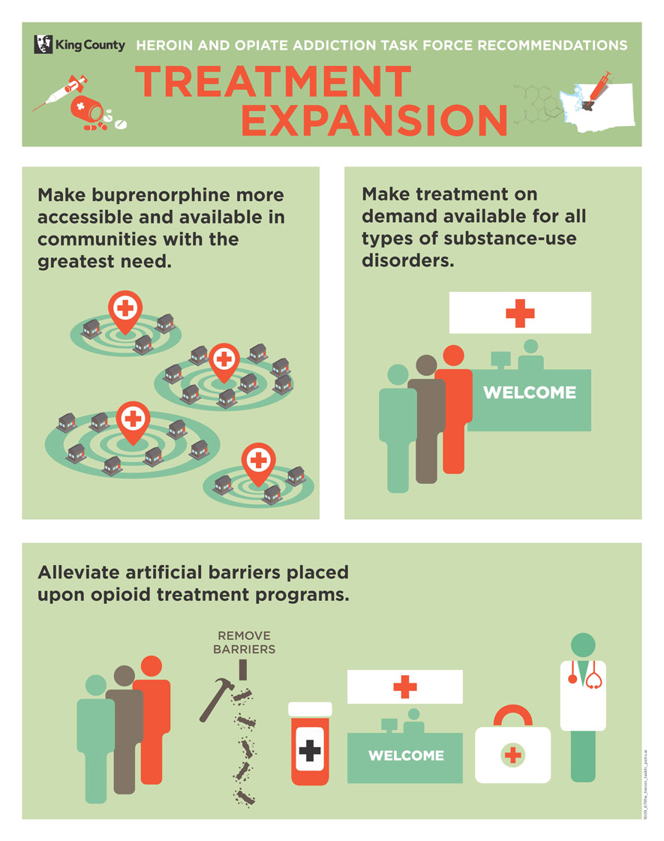

Slide 11
Resources
stopoverdose.org

Slide 12
Community Health Engagement Locations (CHEL sites)
The Task Force will refer to sites that provide harm reduction services where supervised consumption occurs as Community Health Engagement Locations for individuals with substance use disorders (CHEL sites). This terminology recognizes that the primary purpose of these sites is to engage individuals experiencing opioid use disorder using multiple strategies to reduce harm and promote health, including, but not limited to, overdose prevention through promoting safe consumption of substances and treatment of overdose. The Task Force’s equity and social justice (ESJ) charge emphases the importance of providing support and services to the most marginalized individuals experiencing substance use disorders in the County. The Task Force asserts that the designation CHEL sites is a non-stigmatizing term that recognizes that these sites provide multiple health interventions to decrease risks associated with substance use disorder and promote improved health outcomes.

