Slide 1
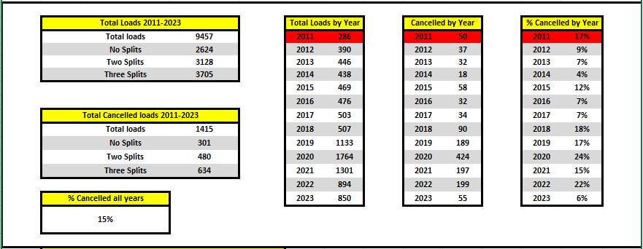
TEFAP Key Statistics as of 07.10.2023

Slide 2
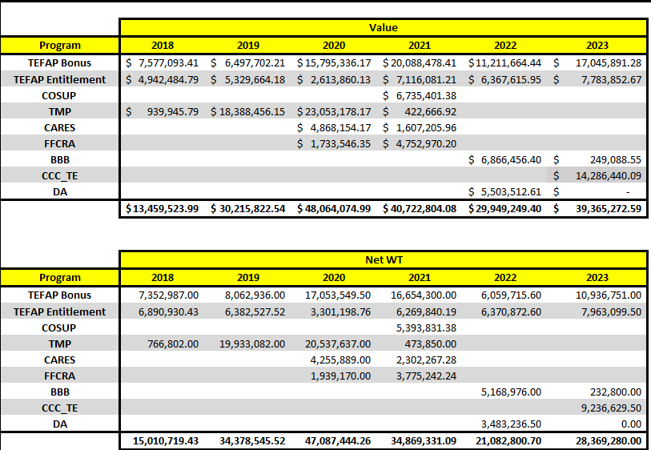
TEFAP Key Statistics as of 07.10.2023

Slide 3
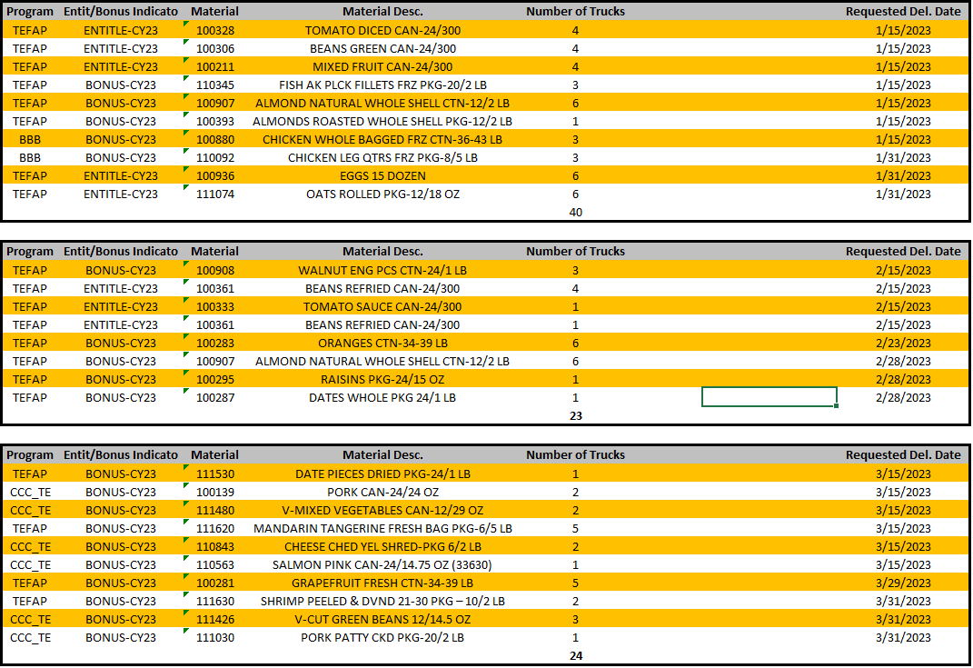
TEFAP Jan, Feb & Mar 23

Slide 4
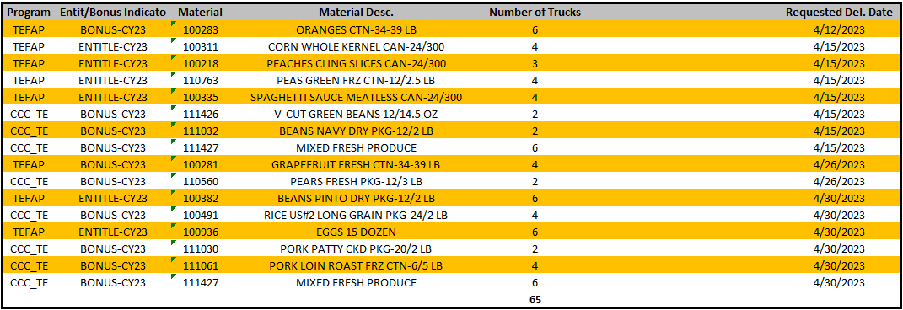
TEFAP April 23

Slide 5
TEFAP May 23

Slide 6
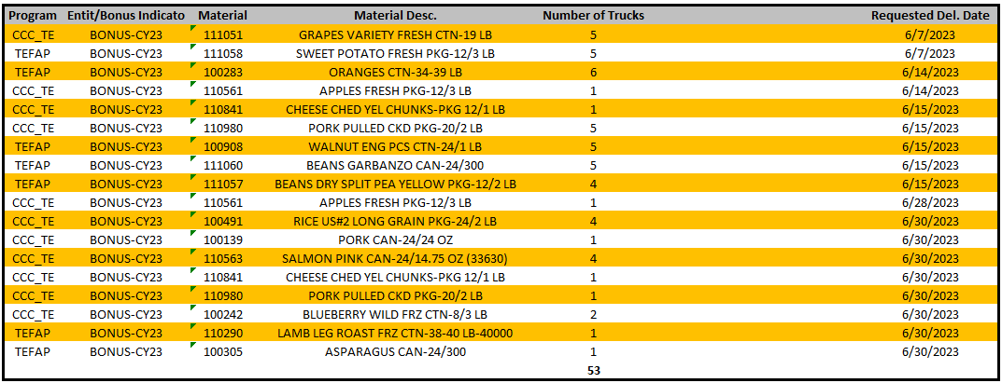
TEFAP June 23

Slide 7
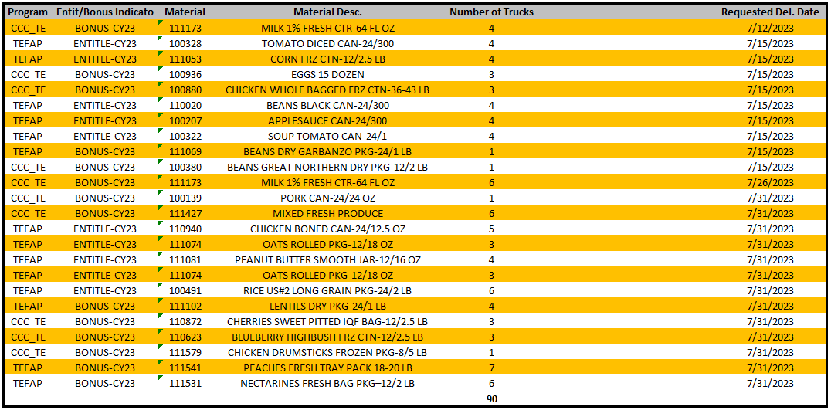
TEFAP July 23

Slide 8
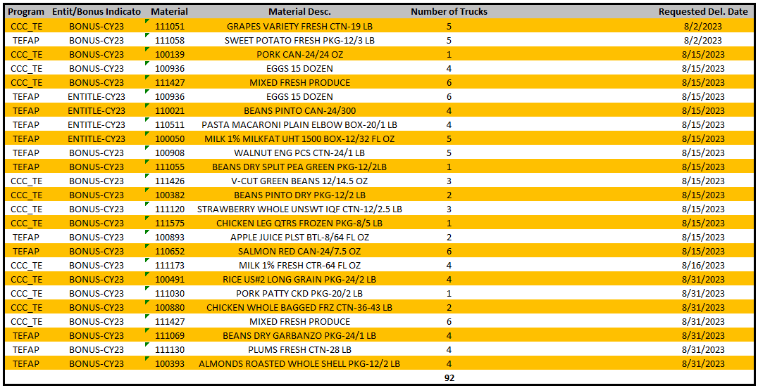
TEFAP August 23

Slide 9
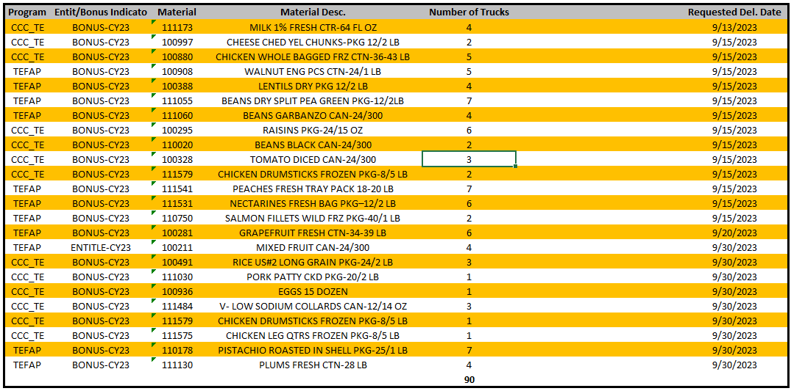
TEFAP September 23

Slide 10
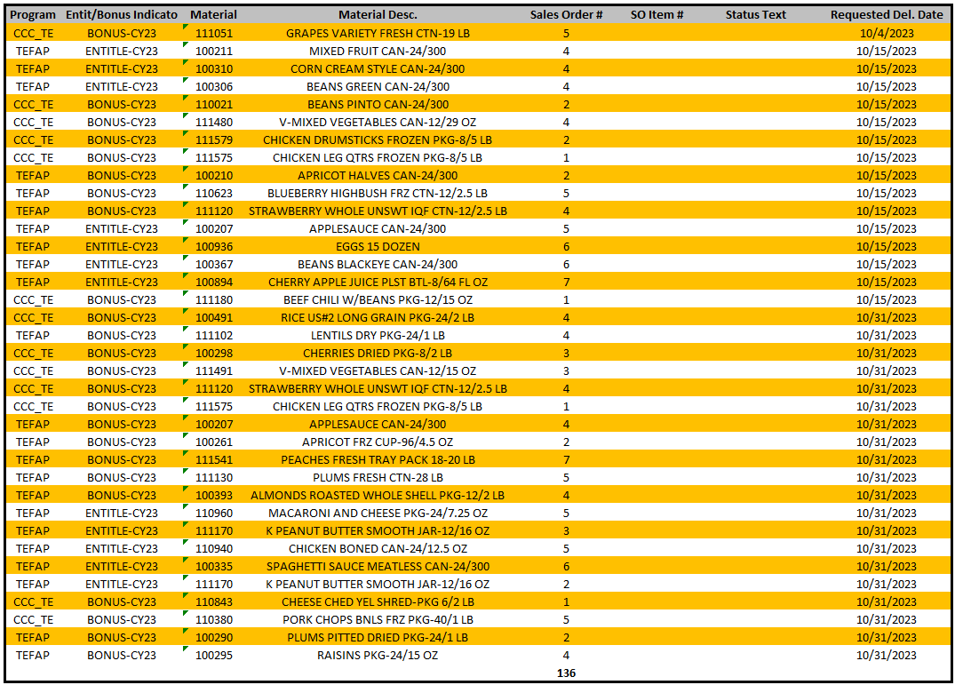
TEFAP October 23

Slide 11
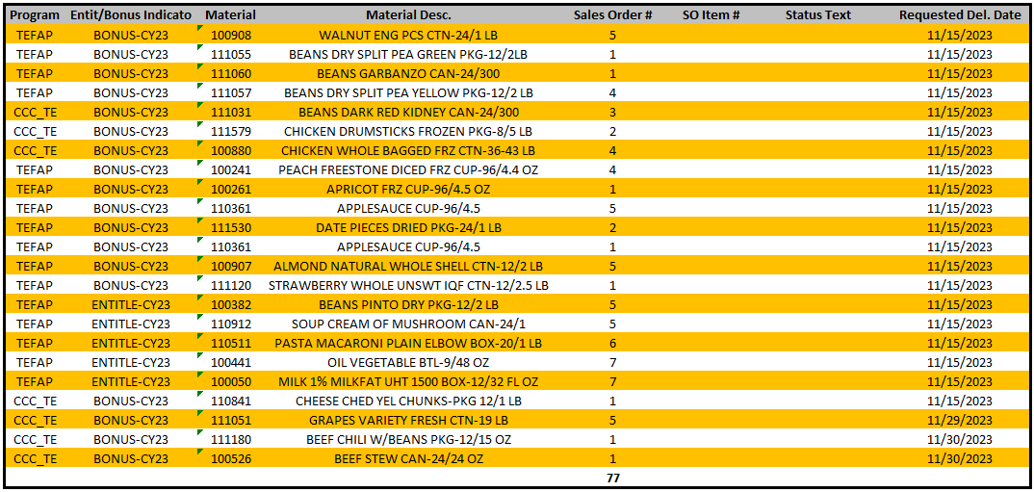
TEFAP November 23

Slide 12
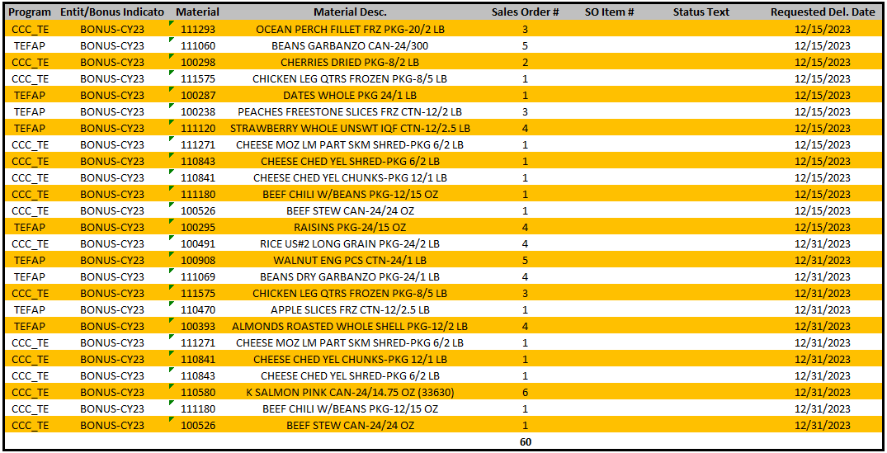
TEFAP December 23

